Slide 1

Energy Ireland Conference 2019
Dublin, 20 June 2019
THE FUTURE ROLE OF GAS
Developing Europe’s Gas Infrastructure
Boyana Achovski, Secretary General, GIE

Slide 2

Gas infrastructure is essential to decarbonise energy
Paris Agreement COP21 - 195 countries agreed to limit global warming to well below 2C cf 1990 temps
Challenge - net-zero carbon emissions by 2050
Problem – EU responsible for 10% global GHG emissions and energy responsible for 75% GHG emissions (and demand is growing)
Solution – decarbonised energy (gas and elec)
Affordable decarbonisation cannot be achieved without using the gas infrastructure
Notes:
2015 Paris Agreement: 195 countries agreed to limit global warming to well below 2C (aim for 1.5C) cf 1990 temperatures
To meet Paris target, need net-zero carbon emissions in EU by 2050
Problem - energy responsible for 75% GHG emissions (and demand is growing)
Solution - mix of decarbonised gas and electricity
But decarbonisation can not be achieved without gases and gas infrastructure
Gas infrastructure allows wider delivery of lower carbon gas and ren energy to all sectors
But first who is GIE?

Slide 3

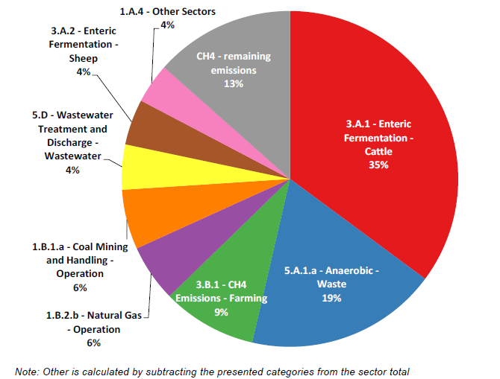
Update on EU methane emissions study
Total EU GHG emissions (in CO_{2-eq})
CH₄ emissions per source
Source: Elaborated by the authors based on European European Environment Agency GHG report and 2016 data
Notes:
Quick update on EU methane emissions study – led by GIE ad Marcogaz
Methane is 11% of EU GHG emissions
Gas industry in EU accounts for 0.6% methane emissions
Report outlines what is being done to measure, report and reduce emissions.
GIE members are committed to reducing all GHG emissions
– available online EC Madrid foruem website

Slide 4
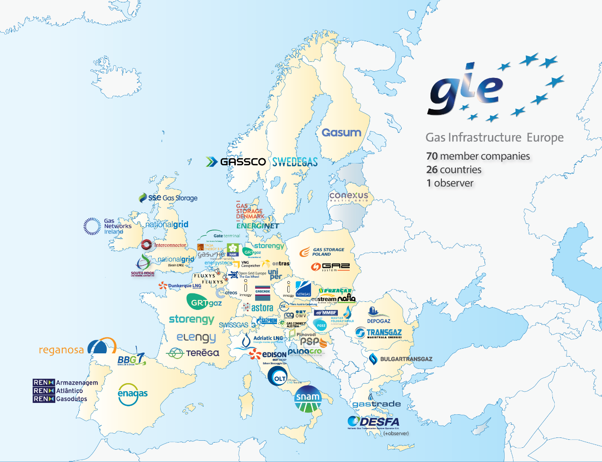



GIE – the Voice for Gas Infrastructure in Europe
GIE is the European representative association for 70 members in 26 EU Member States. Established in 2005.
GIE represents the sole interest of the infrastructure industry in the gas business under three columns:
Transmission (TSO)
Storage (SSO)
LNG (LSO)
GIE focus on the value created from our assets for consumers and users.
GIE works in focused Working Groups under the Annual Working Program
Notes:
GIE …
In summary the gas infrastructure plays a vital role
Now
And in the energy transition
GIE is committed to being part of the solution
And in fact driving some of the solutions towards lower carbon energy in EU …
Through the three Is …

Slide 5

GIE - committed to achieving EU climate targets
Notes:
The gas infrastructure guarantees a safe, reliable network to transport decarbonised energy throughout the EU28 for power, heating and transportation,
integration of all regions of Europe and
innovation for cost-effective renewable energy.

Slide 6
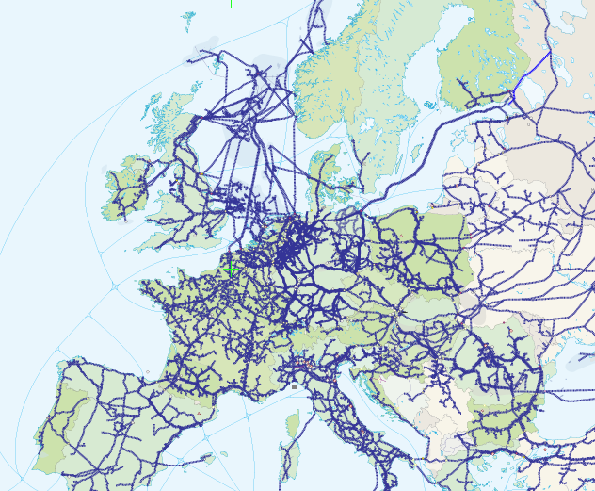

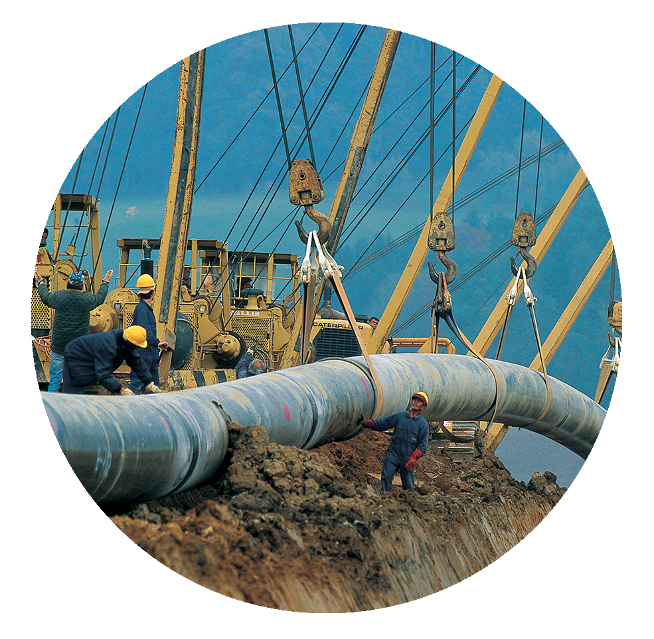
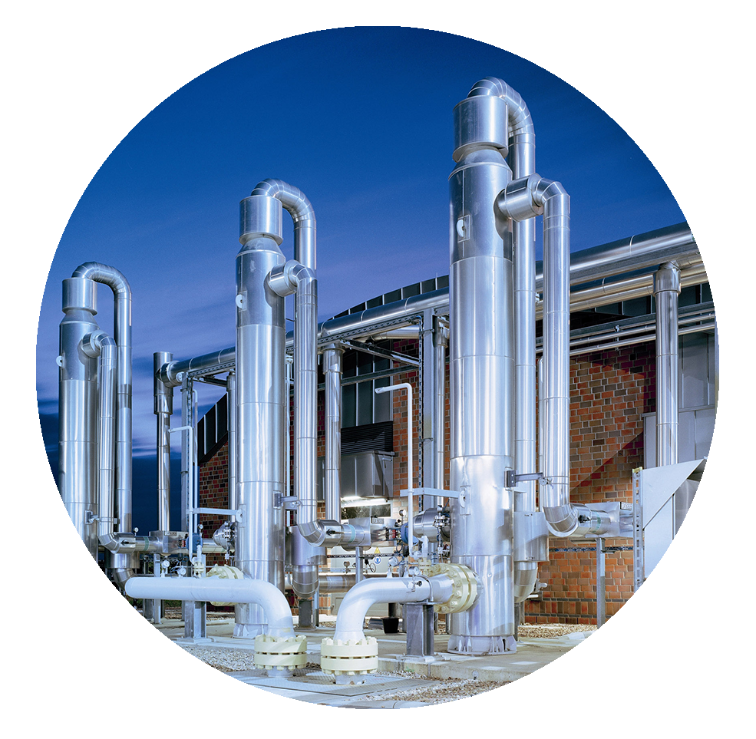
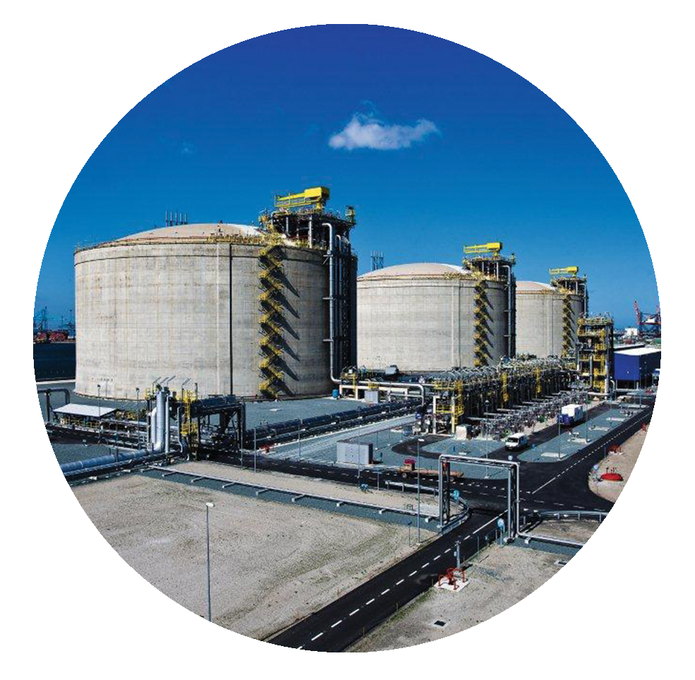
Reliable, secure, affordable energy supply throughout EU
infrastructure
Cost effective way
to decarbonise energy
Notes:
Looking at the gas infrastructure, the key benefits are:
The existing network of LNG terminals, stirage facilities and pipleines that provide a reliable, secure and affordable energy supply throughout EU
I will expand on this and also show the results of recent studies looking at cost

Slide 7
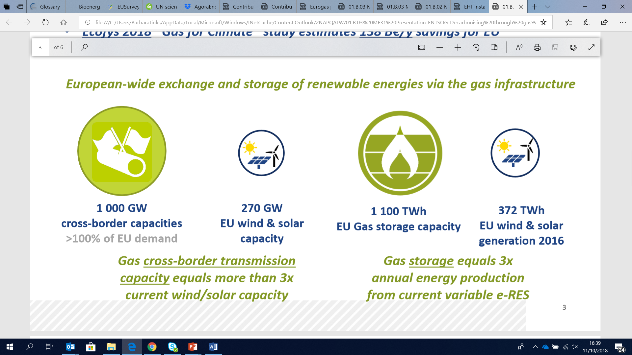
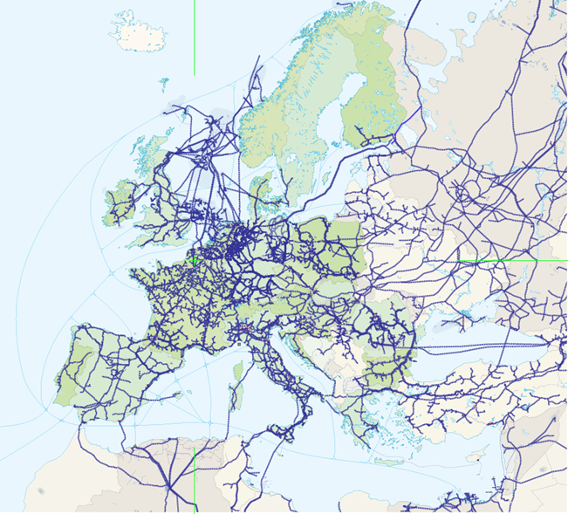

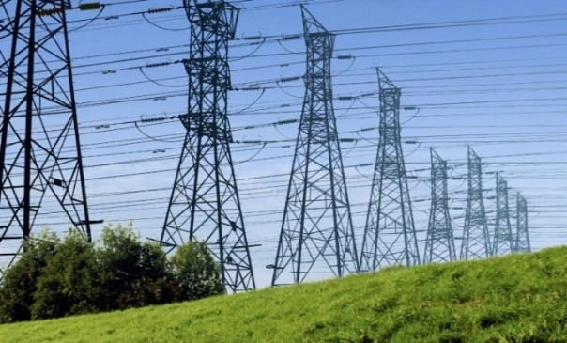

LNG, storage and gas transmission – reliable energy system connecting all Europe
Transmission pipelines
operational
under construction
planned
Data sources : European Environment Agency, ENTSOG TYNDP 2018, EuroStats 2016, GIE maps
GIE Member country
Notes:
Gas transports 10 x energy than elec across EU
Cross-border capacity in gas is 3 x total wind/solar energy produced in 1 year
Today renewable power is directed at power only – only a small sector
Gases can fuel heating, power, industry and transportation
And can be transitioned to “green gases
“renewable” gas = all gases: lower, zero, negative carbon
And of course gas infrastructure is mostly buried:
One buried gas pipeline (ø 1.2 m) transports same amount of energy as 8 parallel high-voltage pylons (each 3 GW).
Existing extensive network across EU and beyond
Interlinked;
Storage and transmission
Lng import terminals
SSLNG plants
Gas transports 10 x energy than elec across EU
Cross-border capacity in gas is 3 x total wind/solar energy produced in 1 year
Today ren is directed at power only – small sector
Gases can fuel heating, power, industry and transportation

Slide 8
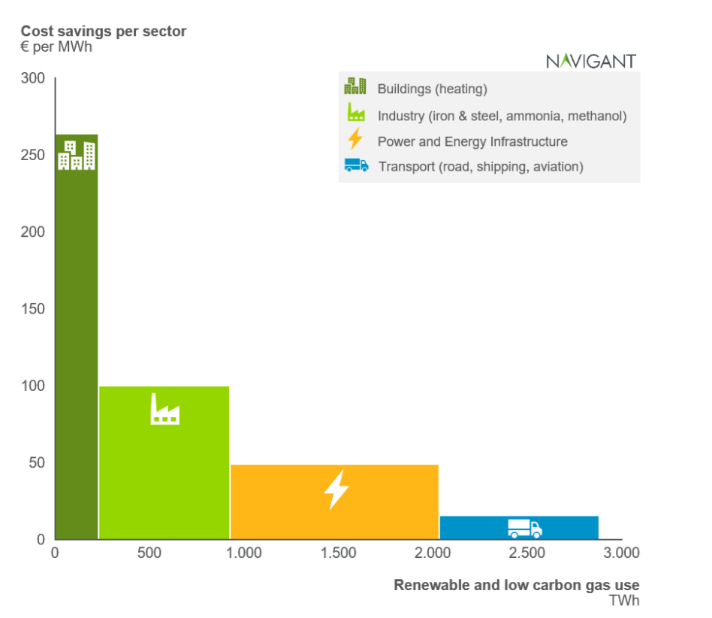

Using gas infrastructure is a cost-effective way to decarbonise energy
Estimated savings for EU, based on higher share of bio/synthetic gas
and use of gas infrastructure vs all-electric scenario:
Pöyry 2018 Decarbonisation Study - €94 Bn pa savings
Ecofys (Navigant) 2018 Gas for Climate Study - €138 Bn pa savings
Eurogas 2018 PRIMES Study - €335 Bn total savings
Navigant 2019 Gas for Climate Study (update) - € 217 Bn pa saving
EU
Notes:
Text on slide
The “optimised gas” scenario in the latest Navigant study assumes that renewable and low carbon gas are used in a smart combination with renewable electricity
The chart on right shows – cost savings are significant inr power and heating in buildings, power and heavy-duty vehicles
Other studies (such as the ECF) do not quantify the amounts of biomass assumed
Therefore we relyon this study to give us a reasobael indication of cost savings

Slide 9

Artelys Study May 2019 – Value of Gas Storage
Main outcomes – gas infrastructure provides:
Flexibility and security; insufficient flexibility for elec system to compensate in case of gas storage reduction
System value; 10% storage reduction would cost €1 B pa in additional elec networks
Less price volatility; 30% reduction in gas storage would result in doubling of power prices
Sector coupling; ability of P2G to reduce power price volatility most effective with gas storage levels
Raw graphic from Perizat to add here

Slide 10
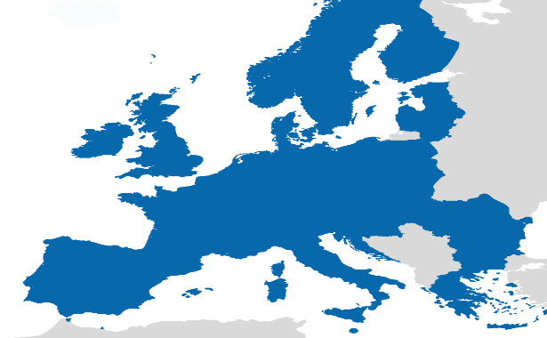
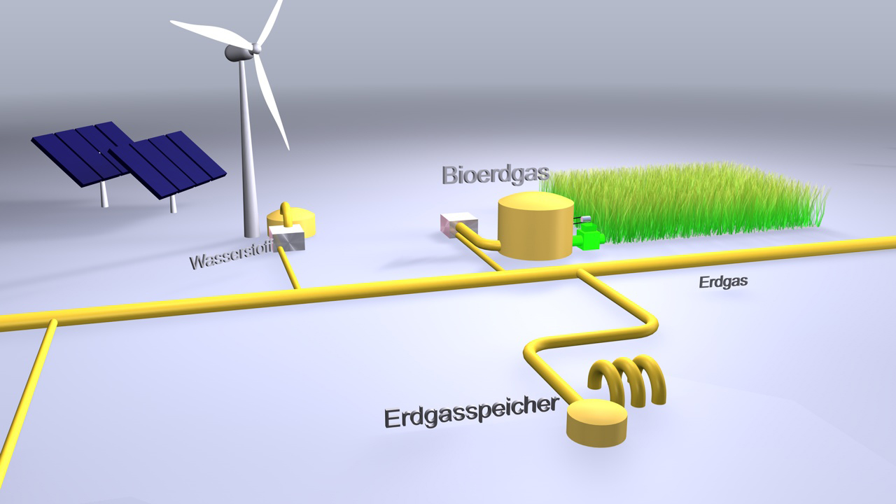
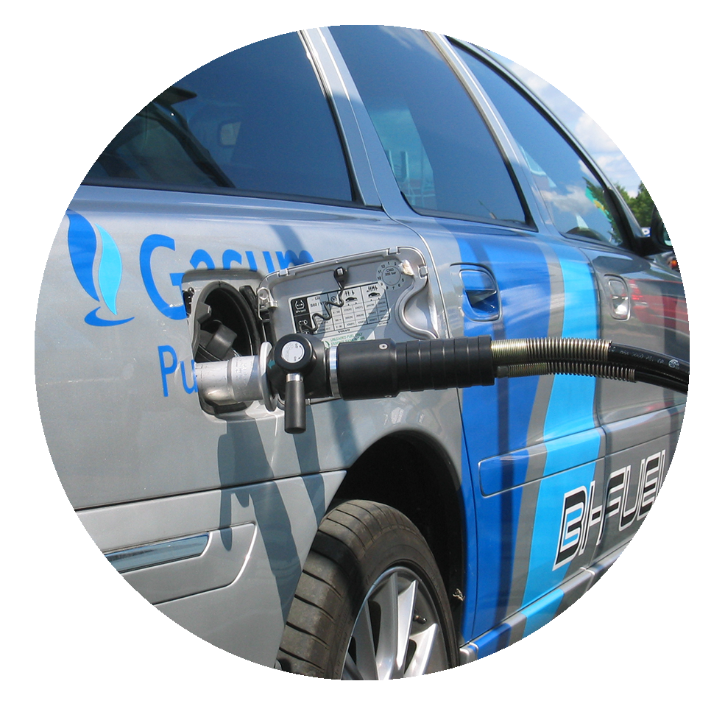
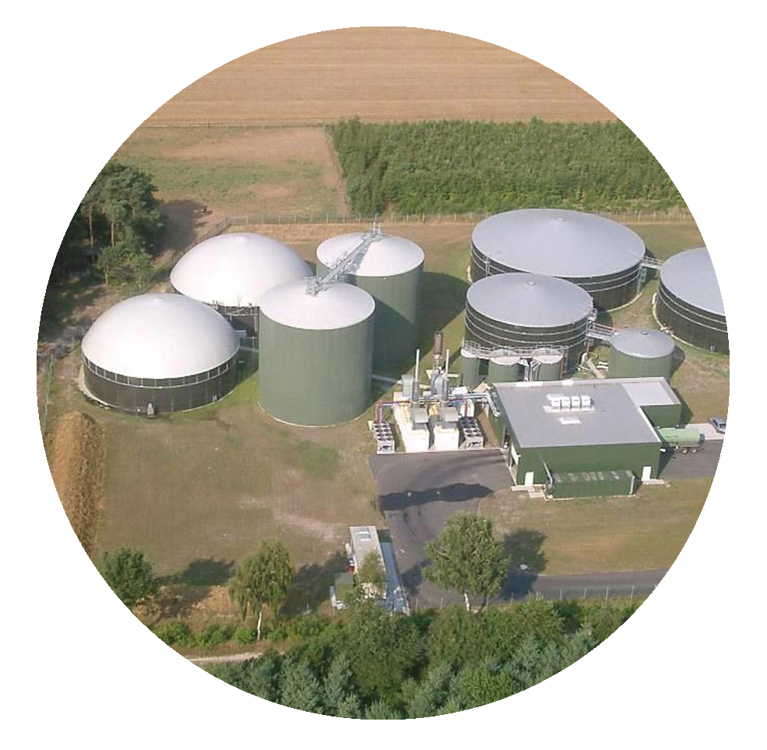
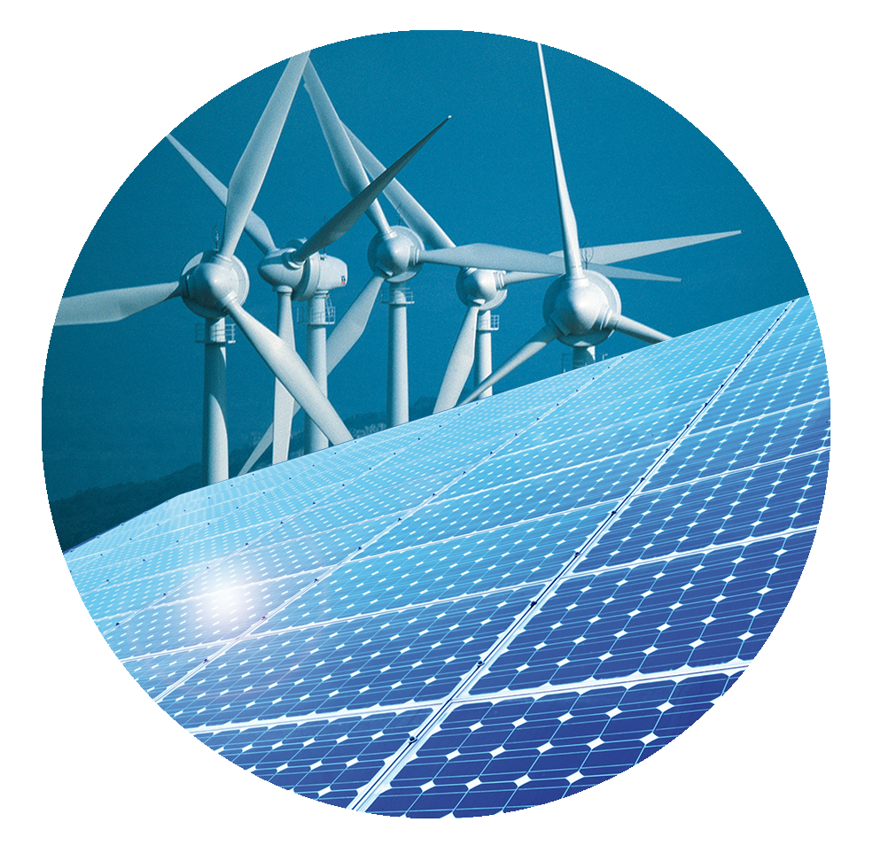
Facilitates a developed EU
energy market
integration
Enables sector coupling/integration and renewable energy storage
Notes:
The gas infrastructure enables:
Integrated EU-wide gas system where energy flows freely without barriers, well before 2050
Well-interconnected, integrated market
All regions achieve comparable levels of market integration, competition, security of supply, liquidity and price convergence

Slide 11
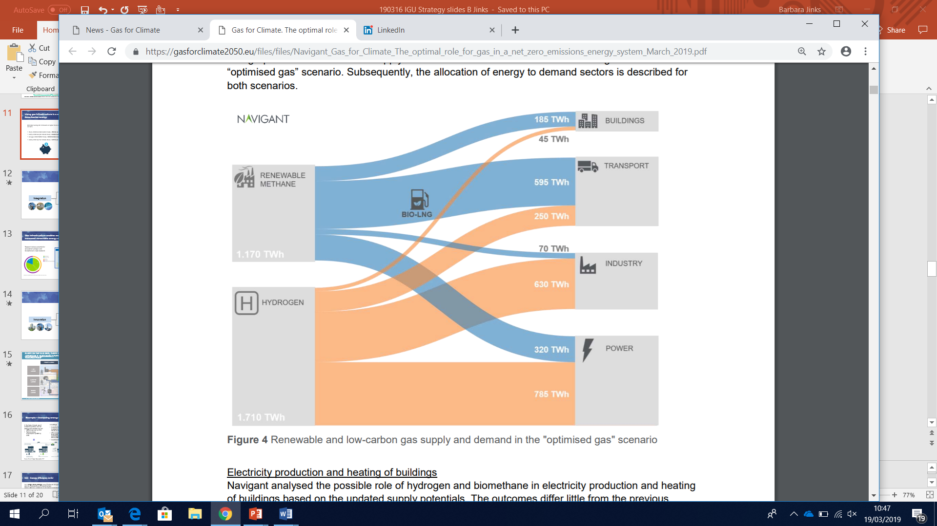
Gas For Climate study March 2019: energy system can become fully renewable
Battery seasonal storage is unrealistic even at strongly reduced costs.
Full decarbonisation of high temp industrial heat requires gas.
Possible to sustainably scale-up renewable gas at strongly reduced production costs.
Blue hydrogen from natural gas with CCSU can be a scalable and cost-effective option.
Potential for renewable hydrogen and biomethane to meet 80% demand (270 bcm).
Notes:
Text on slide
Is asked - the study assumes:
1,170 TWh renewable methane & 1,710 TWh hydrogen
270 billion cubic metres of natural gas (energy content).

Slide 12
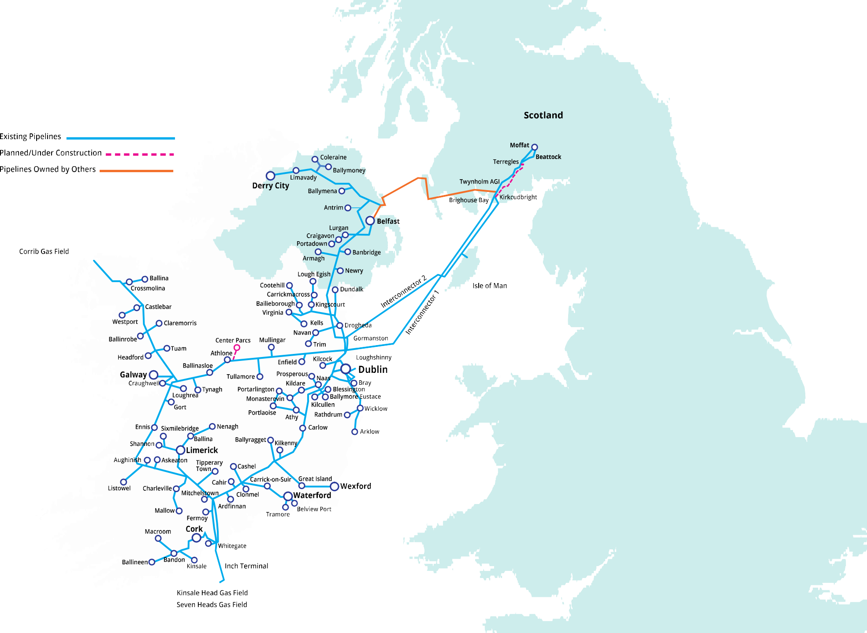


2030 Vision
GNI owns and operates one of the most strategically important energy assets in the country. GNI has a vision to utilise this strategic asset to assist Ireland in achieving a number of core national objectives.
11 TWh
RENEWABLE THERMAL & TRANSPORT ENERGY
9.5 TWh from Agri-AD
20%
NATURAL GAS DISPLACED
5.5m
3.2m Energy + 2.3m Non-Energy
TONNES CO2 SAVINGS ANNUALLY
375
11m
8m
TONNES ANNUALLY
TONNES ANNUALLY
AGRI AD PLANTS ACROSS IRELAND
SILAGE REQUIREMENT
(or equivalent)
SLURRY REQUIREMENT
(or equivalent)
INVESTMENT
€3b
18
560
CENTRALISED INJECTION POINTS
SPECIALIST GAS TRANSPORTATION TANKERS
Notes:
For example, an example of sector integration - the Gas Network Ireland 2030 Vision shows:
gas network can be used to reduce emissions in Ireland by over 17.5 million tonnes of CO₂ per annum by 2050 - compared with 2016 levels.
targets 11.5 TWh renewable biogas production by 2030 (20% of current demand).
A KPMG report, commissioned by Ervia, parent company of GNI, has indicated that using renewable gas is the most cost-effective way of decarbonising the heating of the 1 million homes located close to the existing gas network. There are currently approximately 688,000 houses connected to the gas network in Ireland, with plans in place to bring this figure to 1 million.
This study found that extending the gas network to the c. 300,000 homes in close proximity to the existing gas network (‘network infilling’) represents a lower cost option than electrification for these homes.

Slide 13
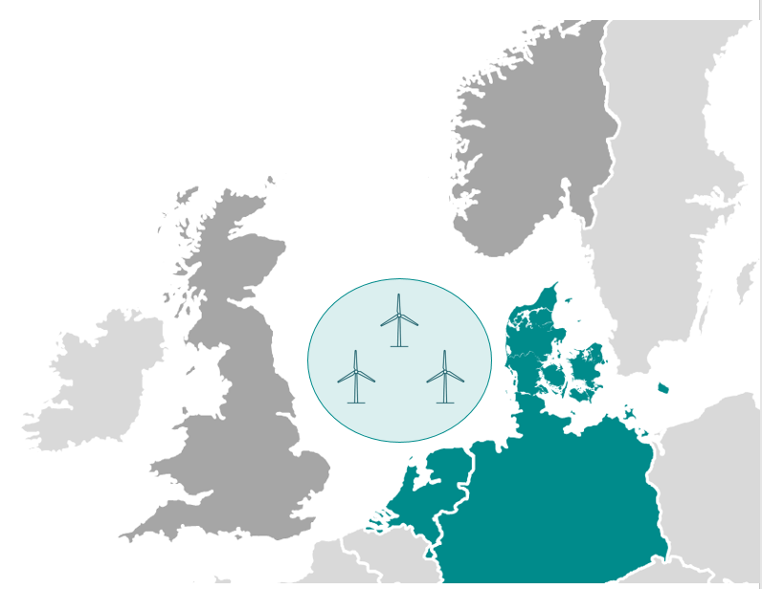
Denmark – PTX increases value of wind/PV
70-150 GW ifrom wind in 2040
App. 7-15 x current capacity
The existing DK energy system cannot deliver without change
North Sea is an important resource – 70-150 MW in 2040 (7-15 x current capacity)
PTX can increase the value of wind and PV-scenario:
  Average market value for wind power and PV increases from approx 0.02 €/kWh in base case to 0.04 €/kWh in PtX-scenario
+ elektrolysis (PtX)
GCA 2040 basecase
Hours
Notes:
Another example of sector coupling – facilitated through the gas infrastructure
Denmark is one of the world's leading countries in terms of the green transition.
Text on slide

Slide 14
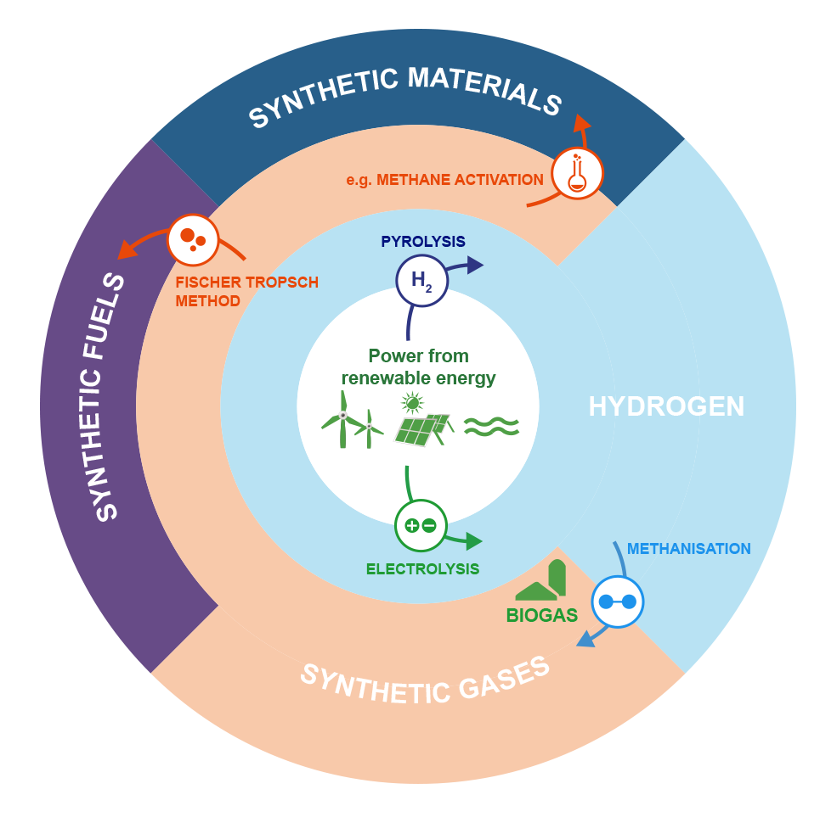
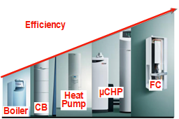

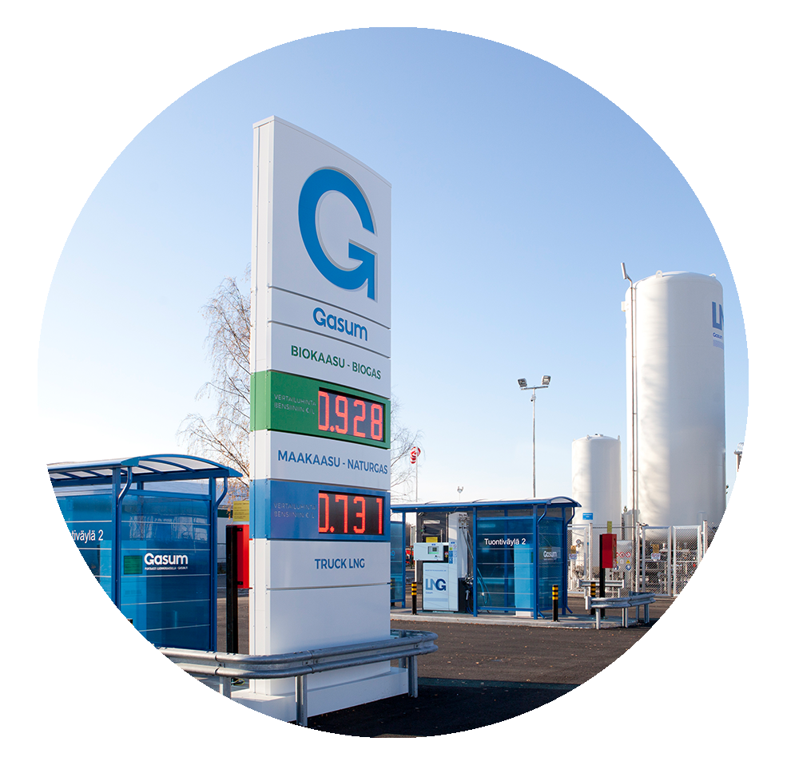
Gas infrastructure can accommodate renewable & decarbonised gases
innovation
Facilitates increased energy efficiency with gas technology
Notes:
Gas infrastructure is the enabler of innovation to assist emission reductions through:
Transporting and storing renewable and lower carbon gases – biomethane, hydrogen and synthetic methane
Enabling increased energy efficiceny with gas technologies

Slide 15
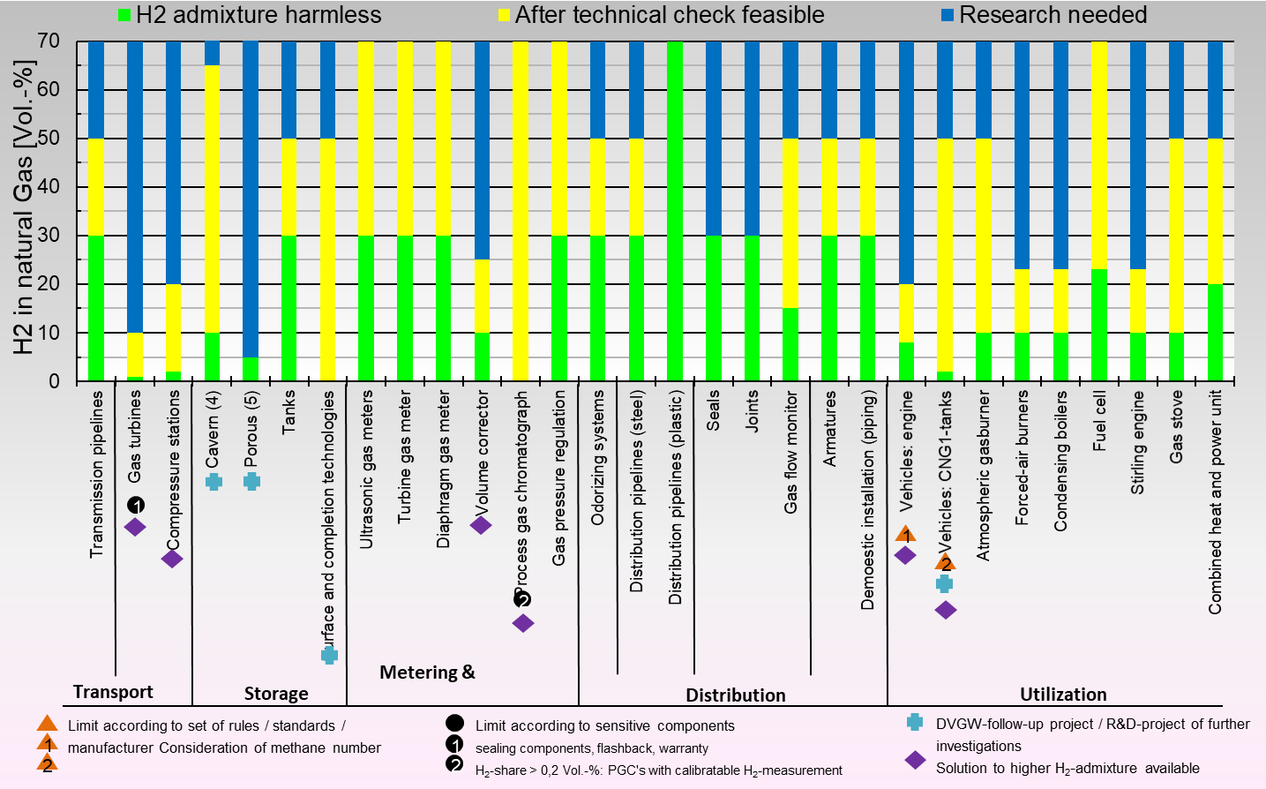
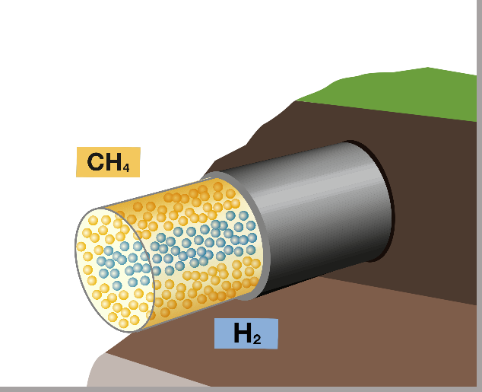
Innovation - gas system can accommodate hydrogen
No technical/physical bottlenecks to transporting hydrogen have been removed.
Max in EU is Germany at 10% allowed; full-scale tests aim for 20-25%.
Hydrogen transport within the gas grid creates a new virtual energy grid throughout Europe.
H2 pipeline carries 5x energy that electricity cable (nat gas x 15).
Source: DBI 2018
Notes:
Marcogaz is developing chart shown on screen
Chart shows how much H2 can be added to the existing gas infra system
Green means it is being done at the moment
Yellow means it is feasible with little effort/cost
Blue means more R&D is required but there is no evidence that it cannoy be achieved
Text on slide
Distribution is 100% ready – key part of supply chain
Injection H2 needs cross border integration
Standardisation important
Why focus on hydrogen?
- speed
Germany leading devt of H2 and mixing with gas (data 2018)
Chart shows ...
* green line across bottom
Yellow means solutions are possible
Blue – research underway
Since 2013 H2 being used in German gas network at 10%
Heading towards 20-25% and remove uncertainties
Distribution is 100% ready – key part of supply chain
Injection H2 needs cross border integration
Standardisation importan

Slide 16
Role of the gas infrastructure in decarbonising energy
C
Essential now …
… and beyond 2050
Higher efficiency with sector coupling
Large cost savings v new elec networks
Enables transition from nat gas to renew/decarb gases
Sector integration - optimise local resources
Increased renewable energy storage
Socially acceptable
Grid balancing & flexibility, SoS
Delivers affordable energy
Delivers fast emission reductions
Reliable energy supplier
Notes:
In summary –
Text on slide …

Slide 17
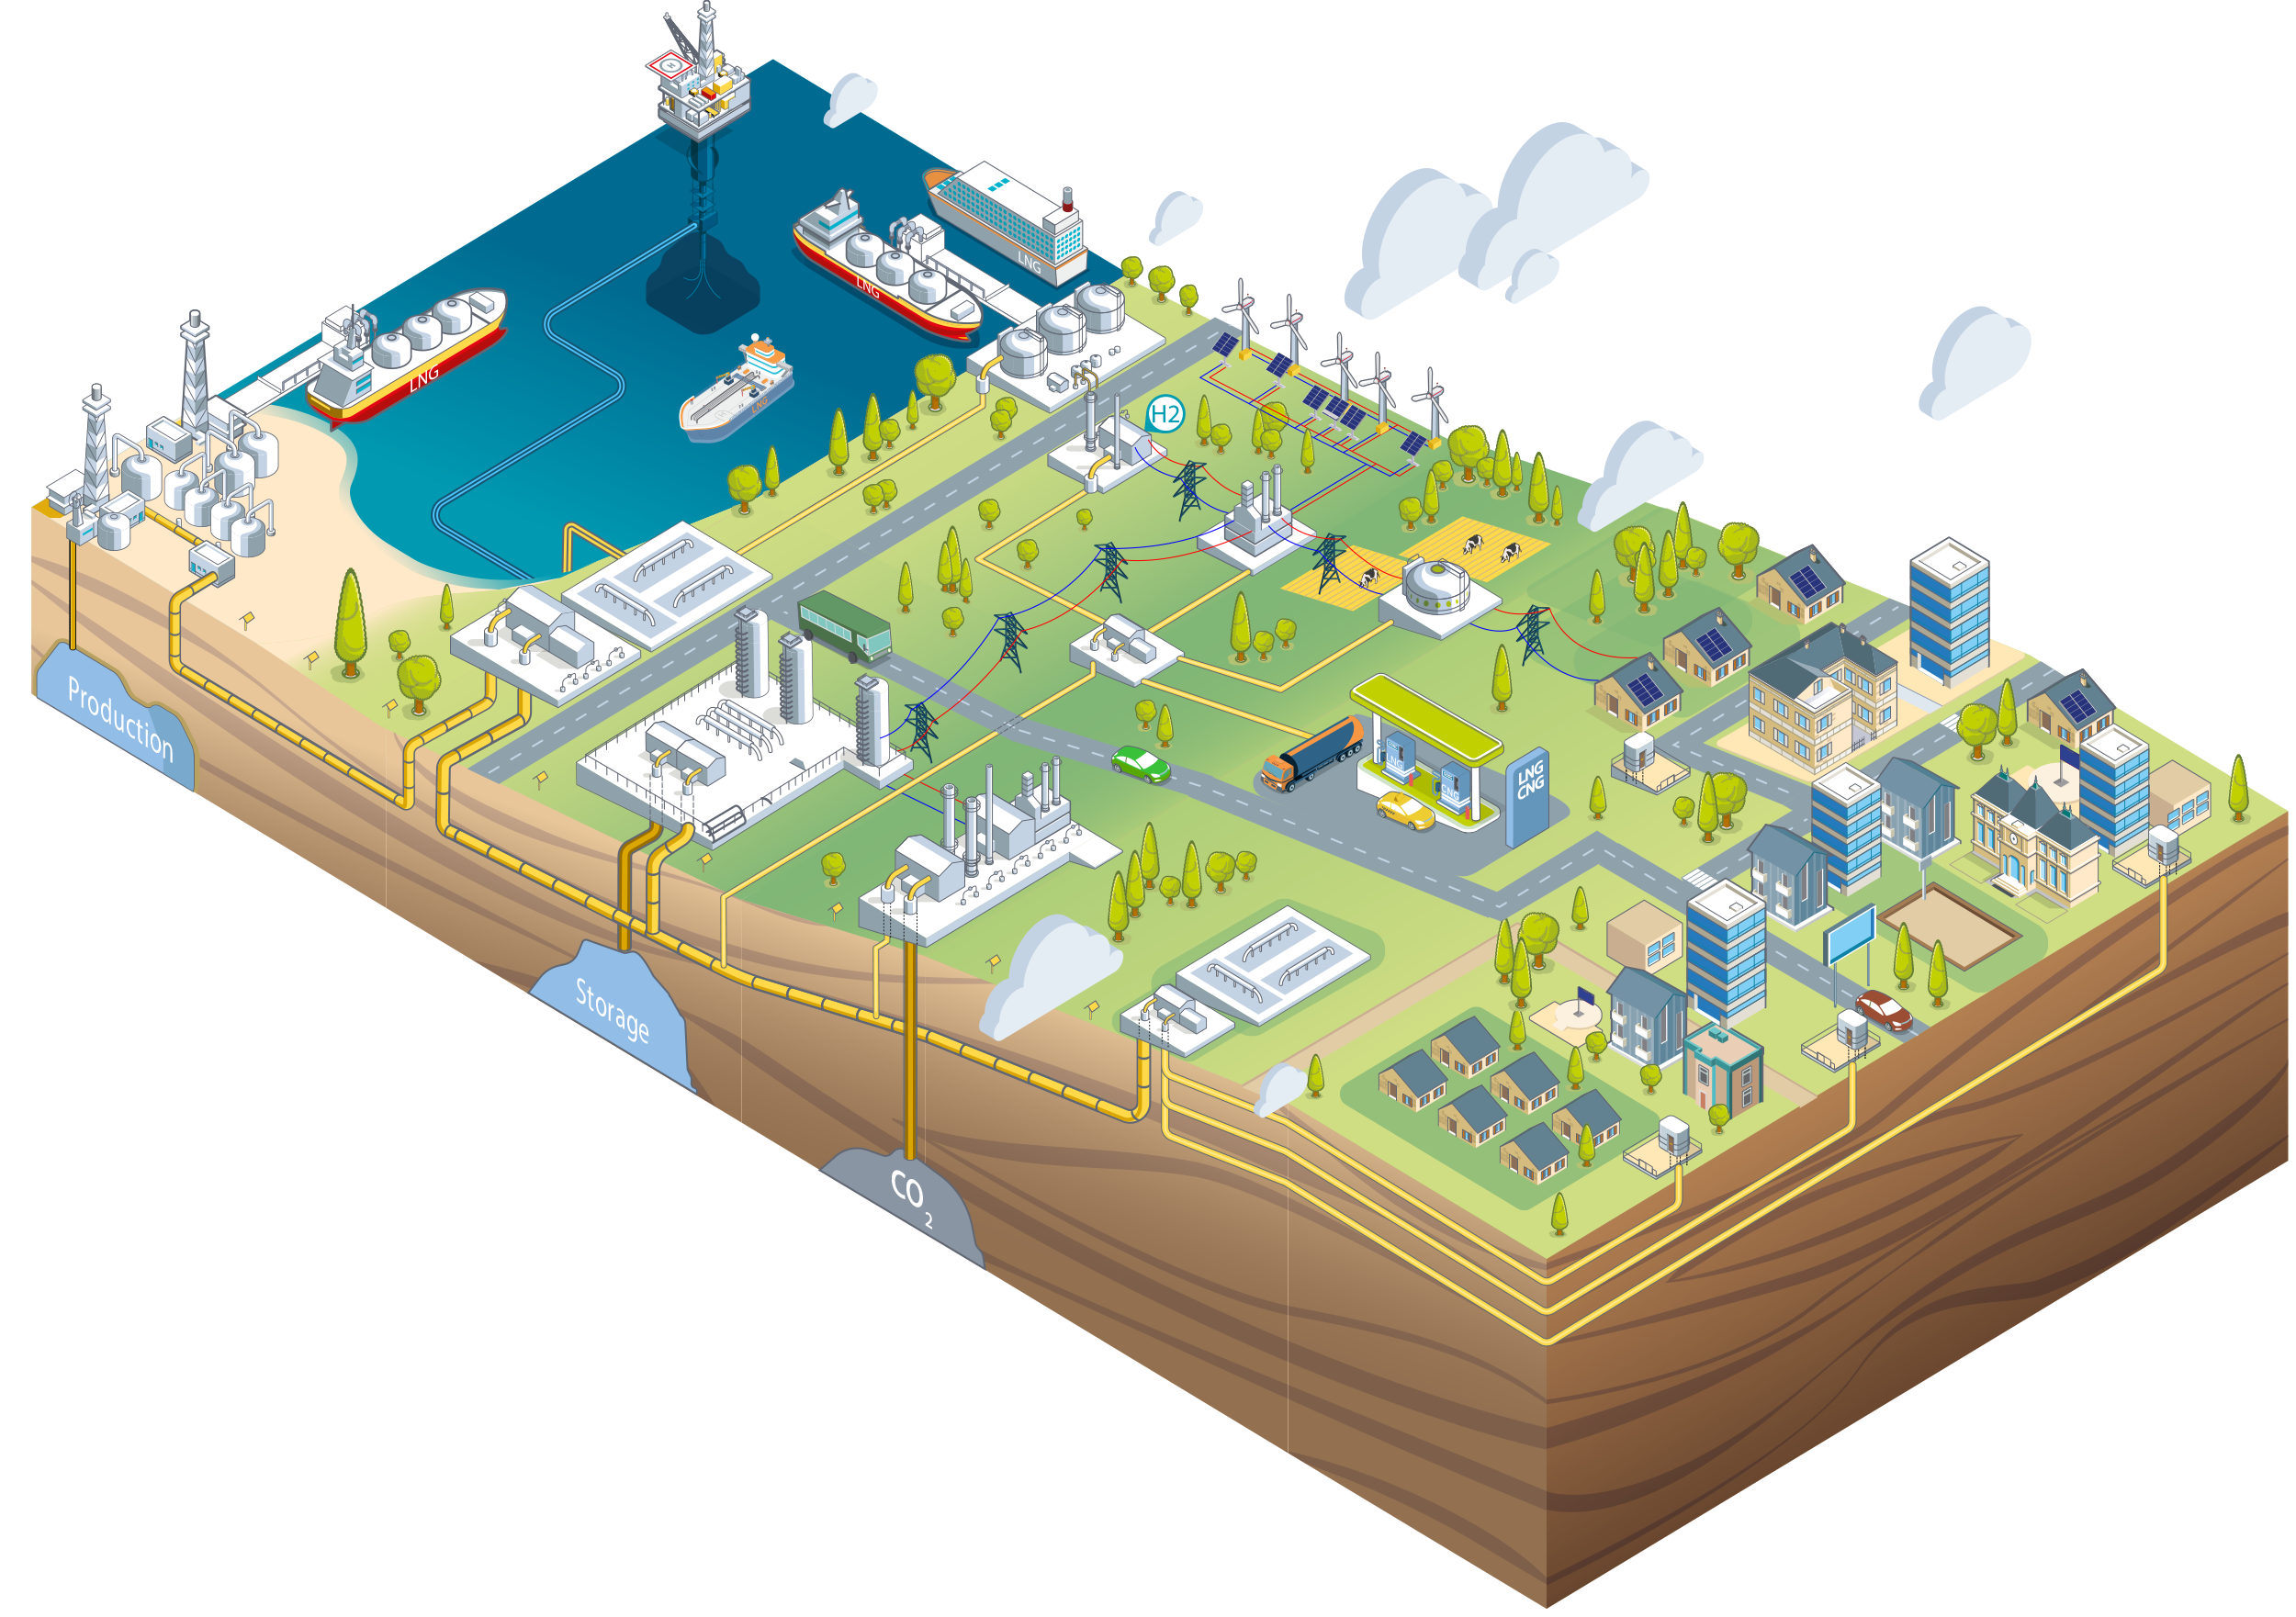

Thank you

